Slide 1

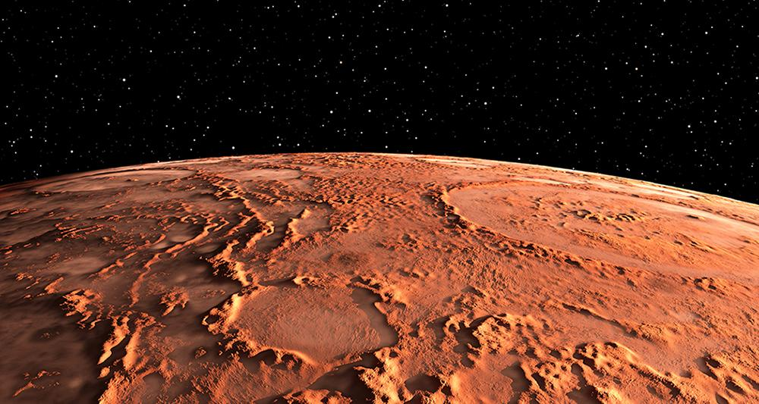

Program for Mars eligible habitable zones
Choose your best place to establish a new civilization on Mars !
BUXTON Lisa – LAGLAIVE Romane
Geospatial programming course by DILEKLI Naci
Notes:
Lisa

Slide 2
Summary
Introduction
Flowchart
Project presentation
Analysis results
Live demonstration
Notes:
Lisa

Slide 3
Flowchart
Notes:
Romane

Slide 4
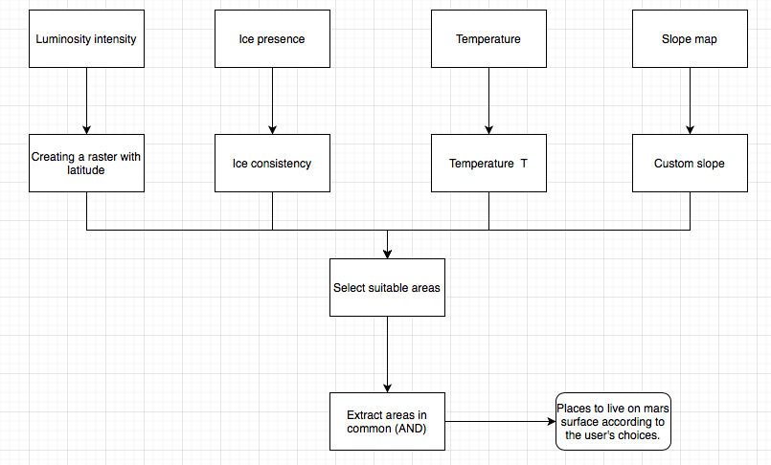
Flowchart
Notes:
Romane

Slide 5
Project presentation
Visualization map
Program start
Notes:
Romane

Slide 6
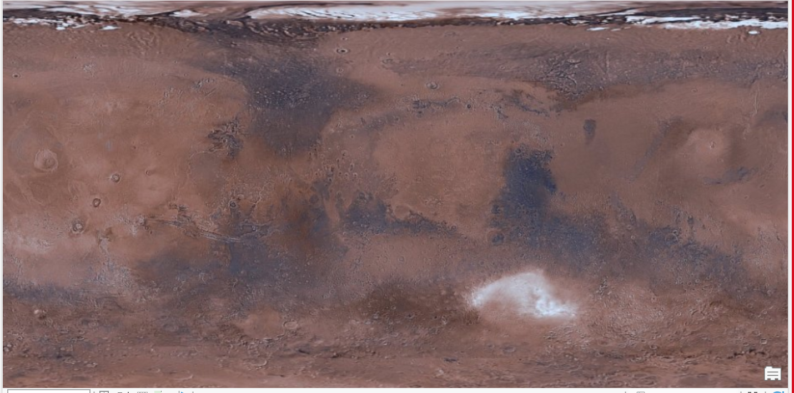
Visualization map
Notes:
Romane

Slide 7
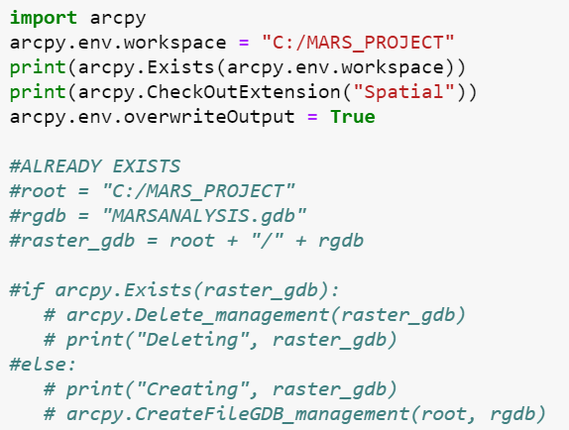
Program start
Importation of the arcpy library
Creation of a new output geodatabase for our analysis
Notes:
Romane

Slide 8
Project presentation
Input parameters
Relief
Temperature
Ice consistency
Luminosity intensity
Notes:
Lisa

Slide 9
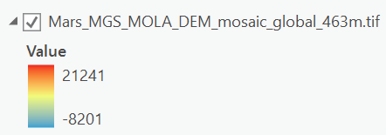
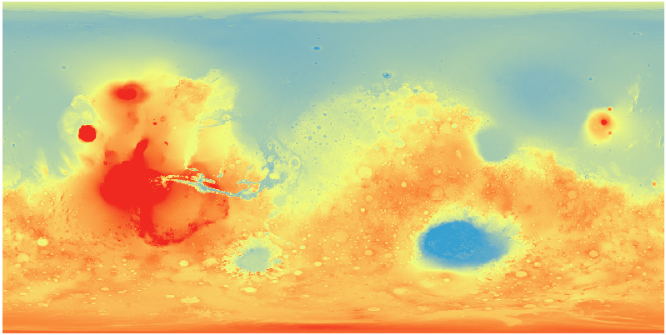
Relief map
Relief in meters
Notes:
Lisa

Slide 10
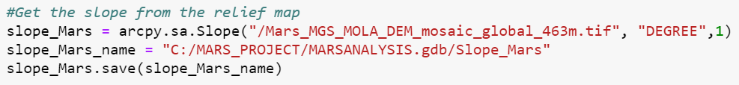
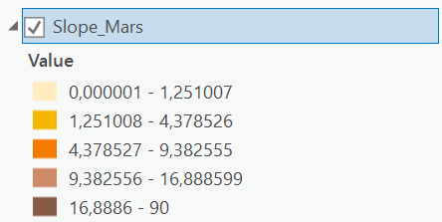
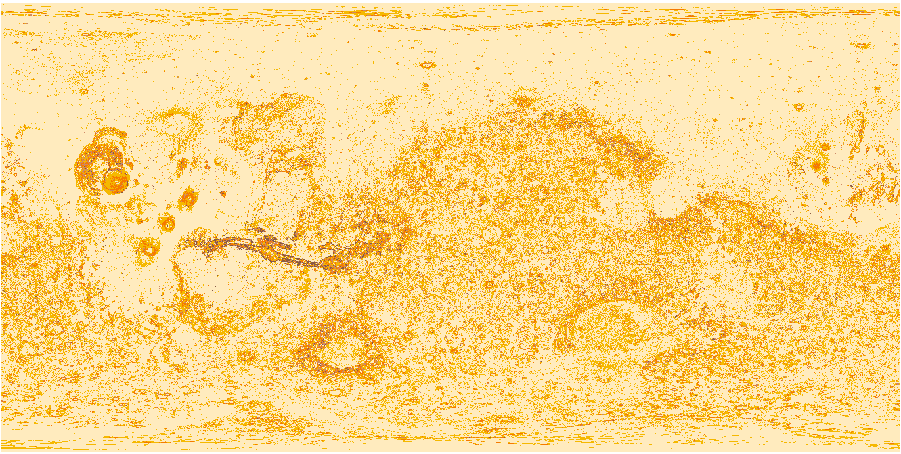
Relief map
Creation of the slope map
Notes:
Lisa

Slide 11
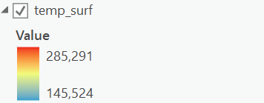
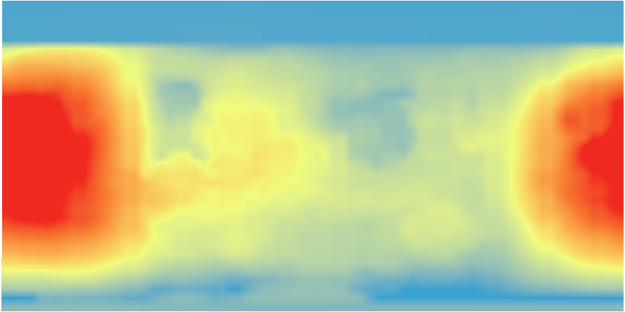
Temperature map
Temperature in Kelvin
Notes:
Lisa

Slide 12
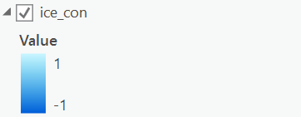
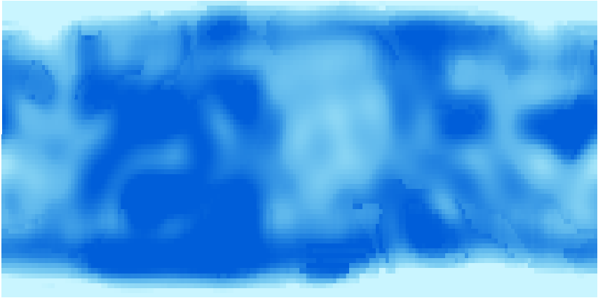
Ice consistency
Ice consistency bewteen 0 and 1 meter under the surface of Mars
Notes:
Romane

Slide 13
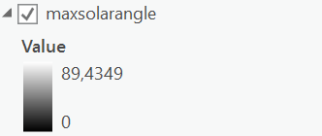

Luminosity intensity
Sun angle in degrees
Notes:
Romane

Slide 14
Project presentation
Program
Notes:
Lisa

Slide 15
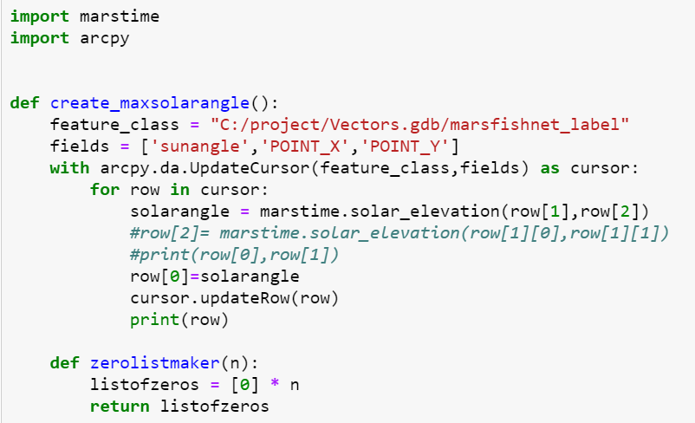
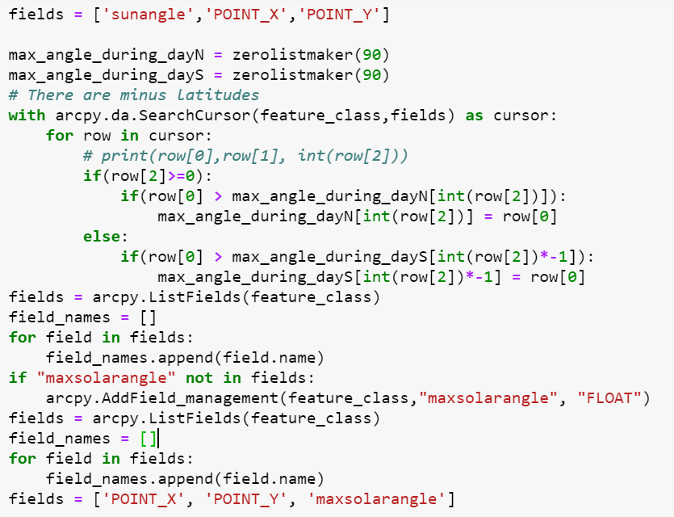
Function to get the luminosity intensity raster
Importation of marstime library
Use of a mars fishnet
Notes:
Lisa

Slide 16
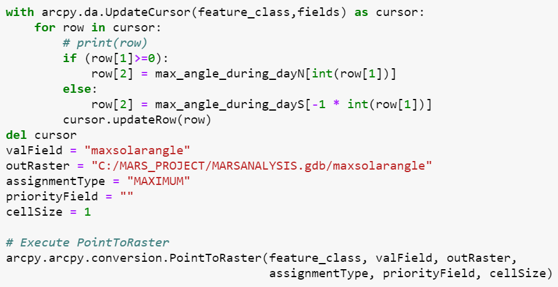
Function to get the luminosity intensity raster
Raster saved in the output geodatabase
Notes:
Lisa

Slide 17
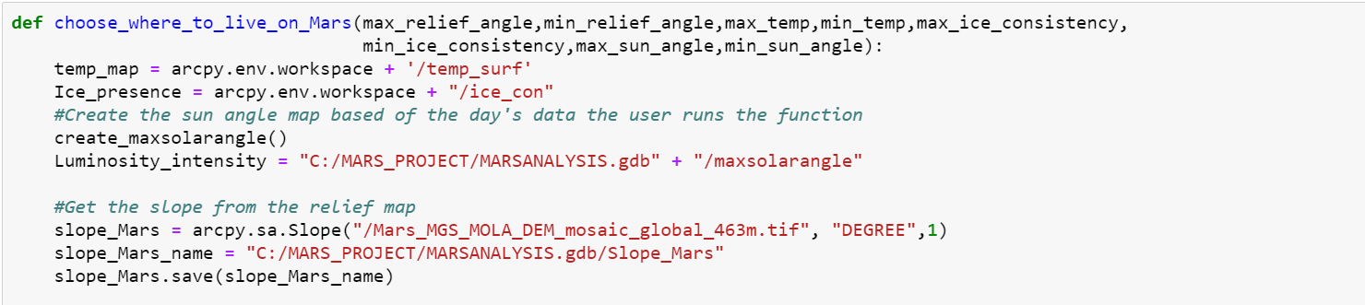
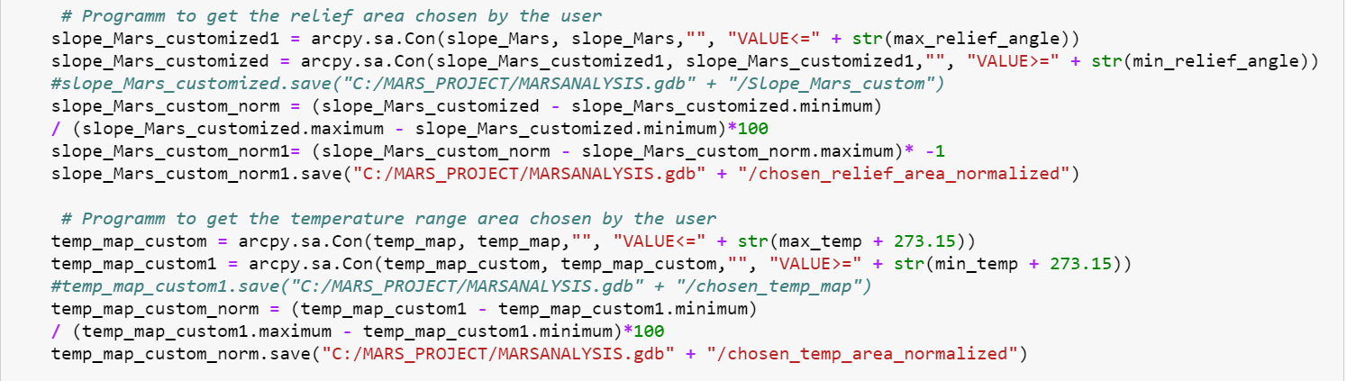
Main function of the program
Notes:
Lisa

Slide 18
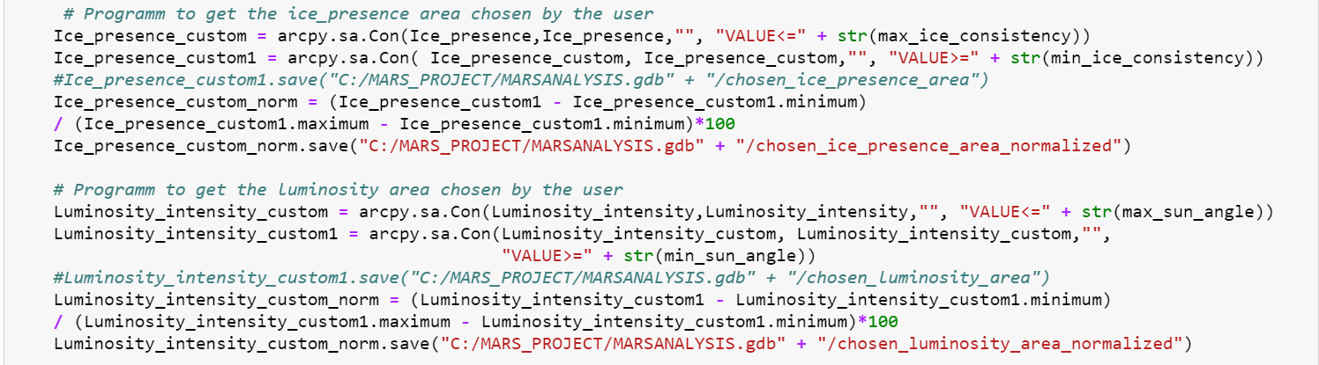
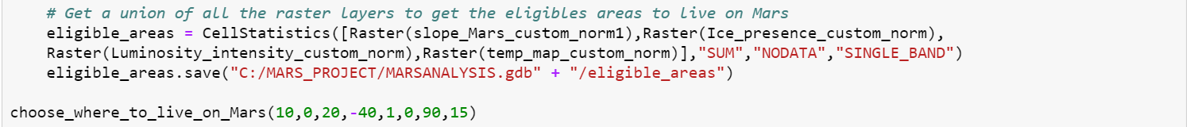
Main function of the program
Notes:
Romane

Slide 19
Analysis results
Visualization on ArcGIS
Notes:
Romane

Slide 20
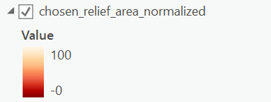
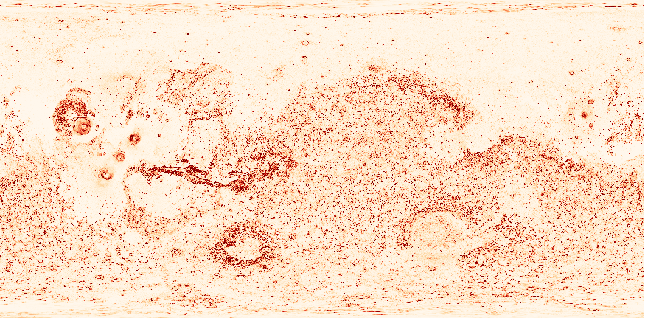
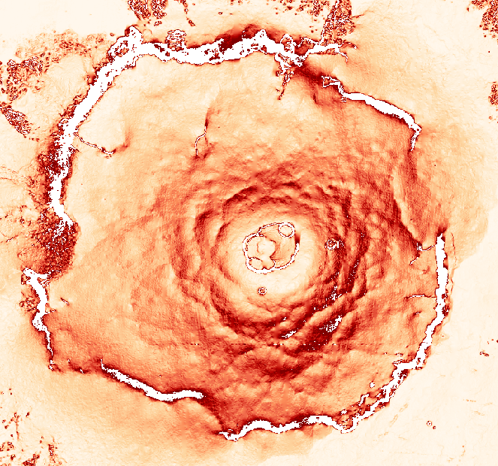
Slope map analysis
Customization with the user’s values + normalization
Zoom
Blank = no data
Angle in the blank area > max user’s angle or < min user’s angle
Notes:
Romane

Slide 21
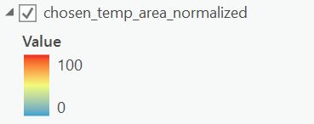
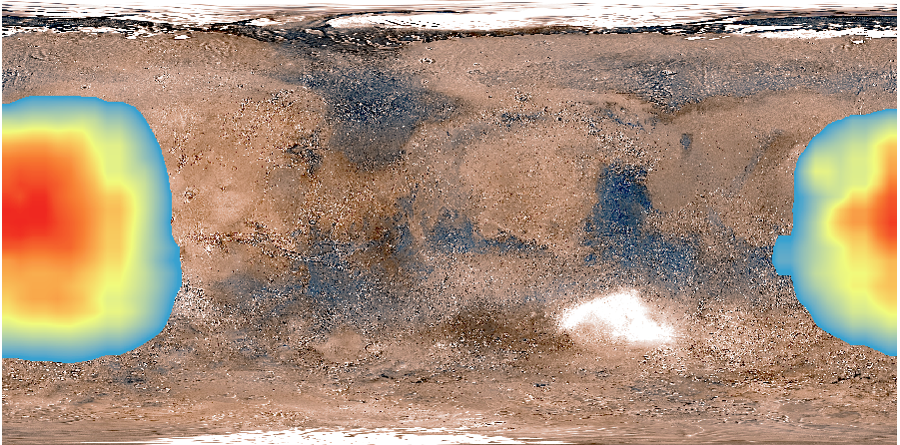
Temperature map analysis
Customization with the user’s values + normalization
Notes:
Romane

Slide 22
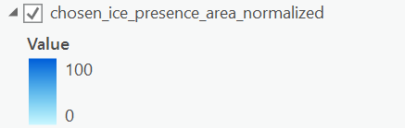
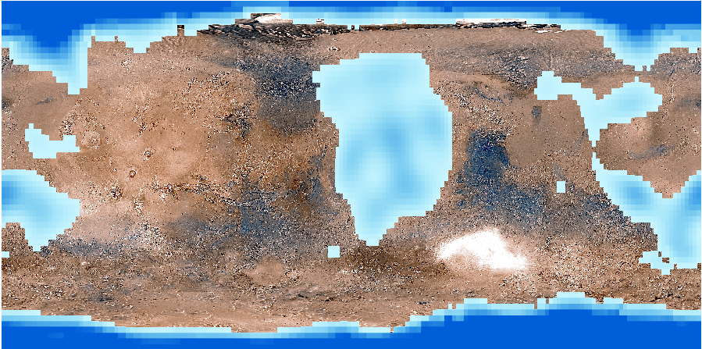
Ice consitency map analysis
Customization with the user’s values + normalization
Notes:
Lisa

Slide 23
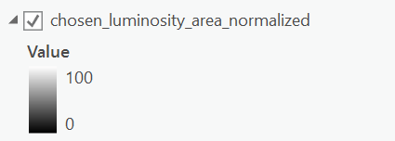

Luminosity intensity analysis
Customization with the user’s values + normalization
Notes:
Lisa

Slide 24
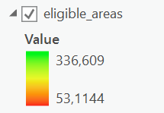
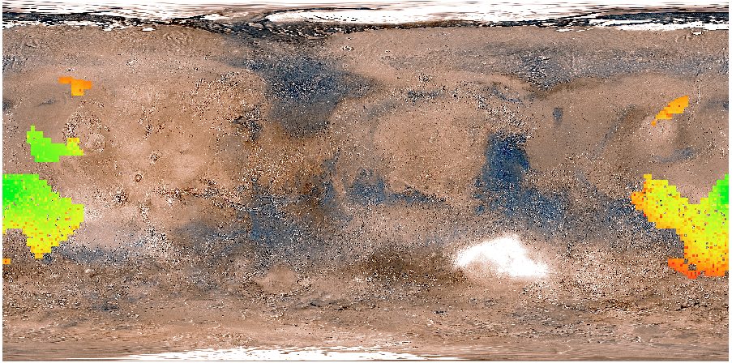
Eligible areas for the user
Sum of every raster layer to find the areas that fulfill every user’s condition
Notes:
Lisa

Slide 25
Thank you for listening!

Slide 26
Live demonstration

